Slide 2
What is Arduino and How it Has impacted the Hardware World
By Tsvetomir Staykov

Slide 3
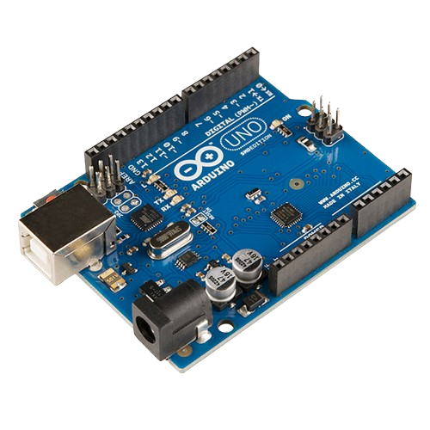
What is this?

Slide 4
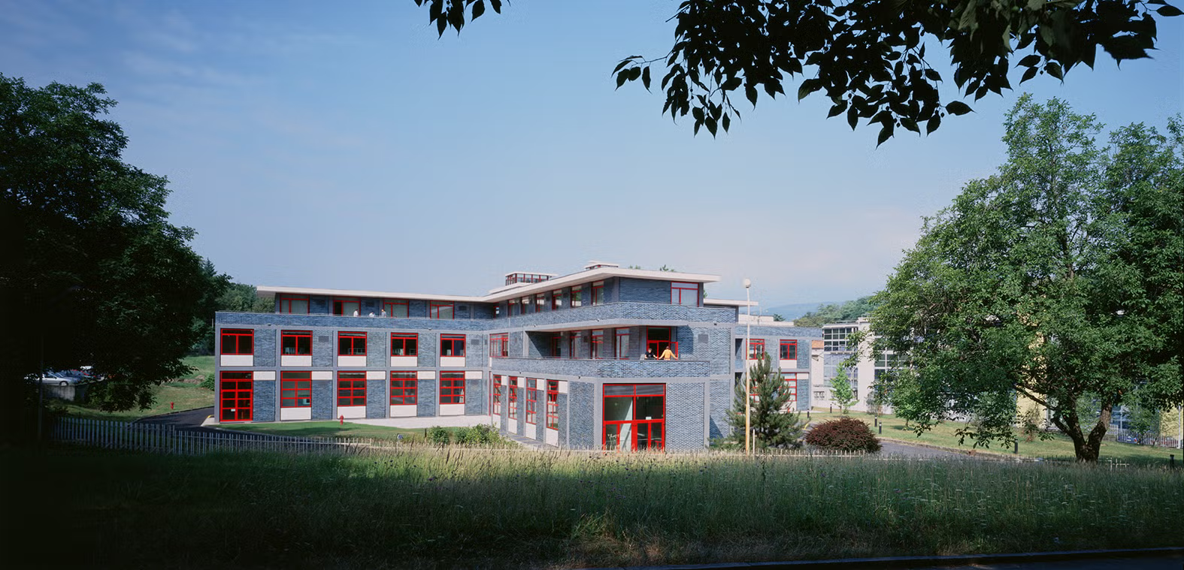
Interaction Design Institute Ivrea

Slide 5
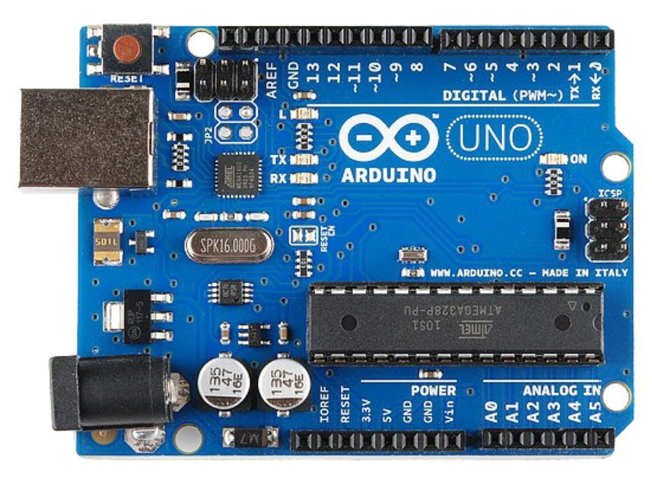

Slide 6
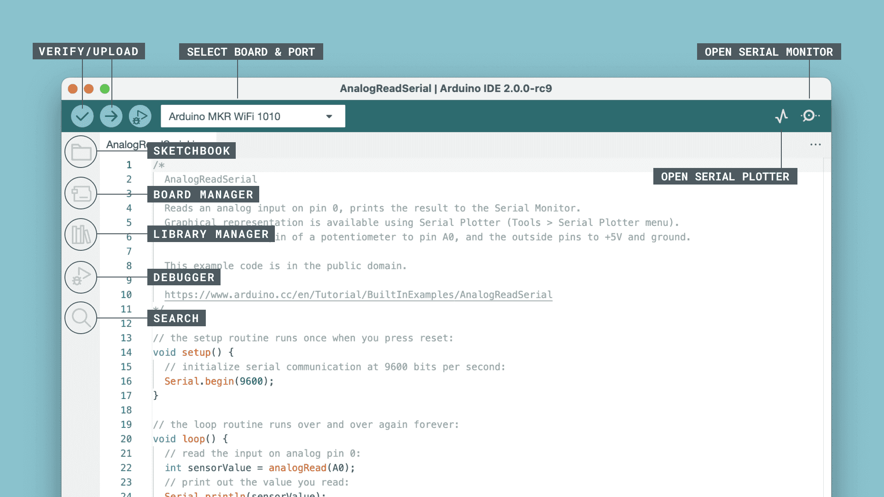
https://docs.arduino.cc/software/ide-v2/tutorials/getting-started-ide-v2/

Slide 7
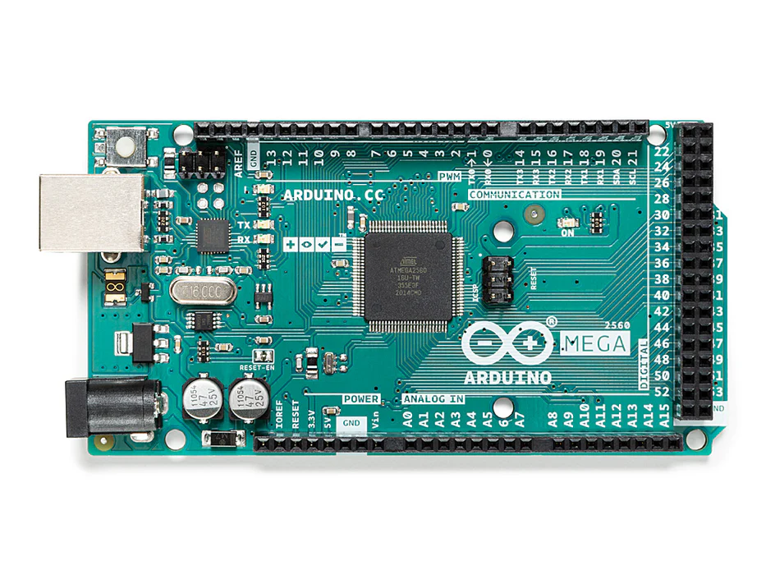
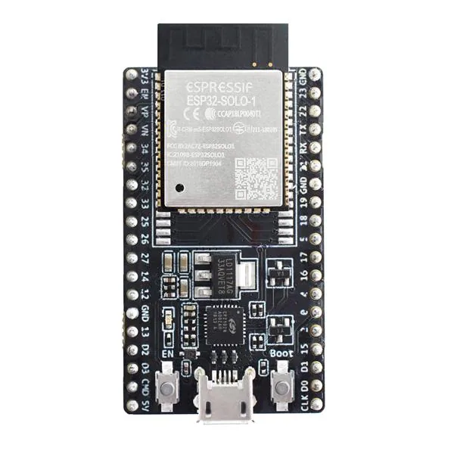
Other versions
ESP32
Arduino Mega

Slide 8
Youtube - Liong Ma MIT Maker Portfolio [Accepted]

Slide 9
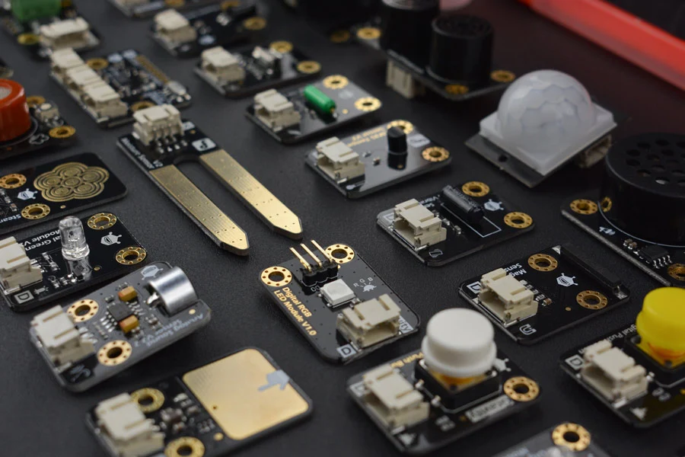
Sensors

Slide 10
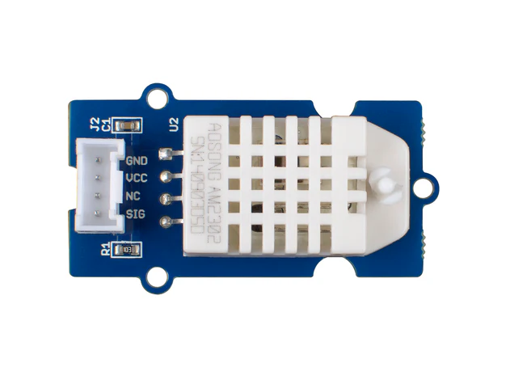
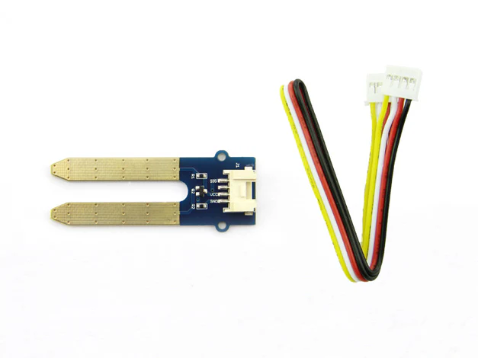
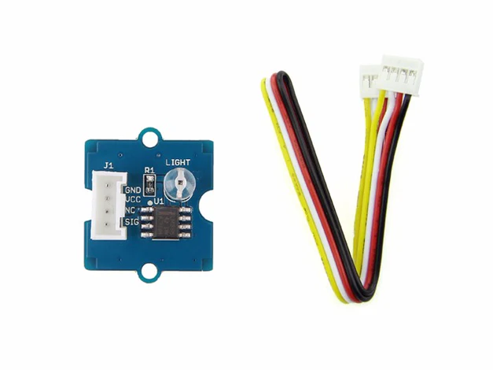
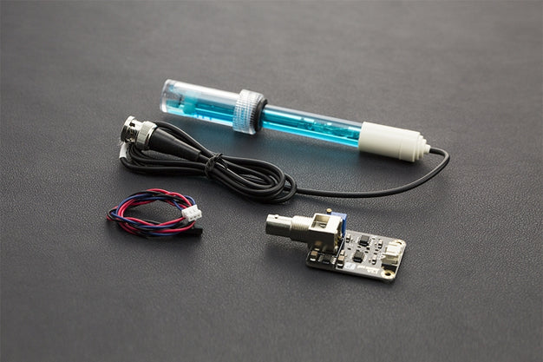
Air quality
Humidity of soil
Light detection
Levels of pH

Slide 11
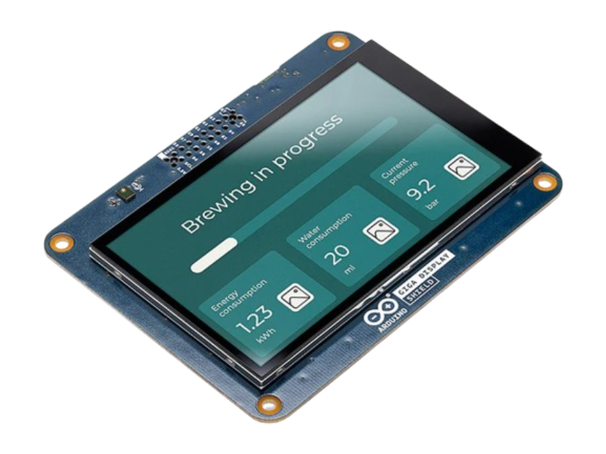
Arduino Shields
https://www.eletrogate.com/shield-multifuncoes-para-arduino-ideal-para-aprendizagem

Slide 12
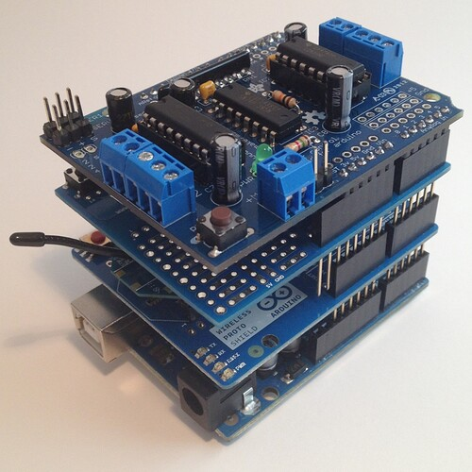
Maybe too much?
https://forum.arduino.cc/t/using-multiple-shields/393230

Slide 13
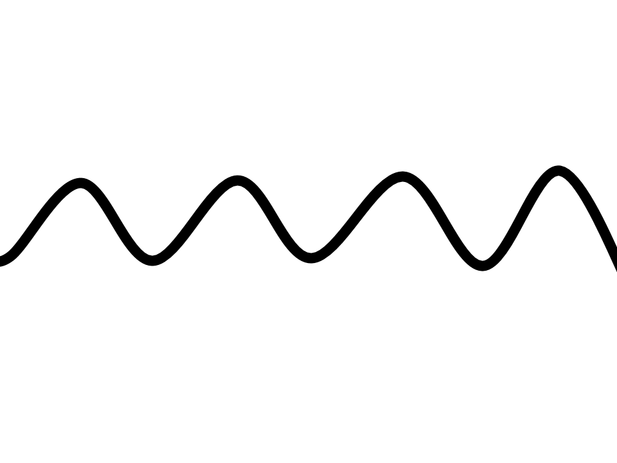
Features:
DAC and ADC

Slide 14
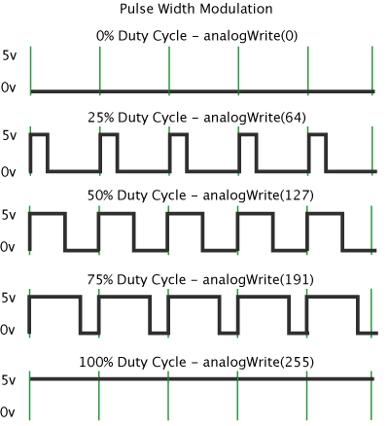
Features:
PWM

Slide 15
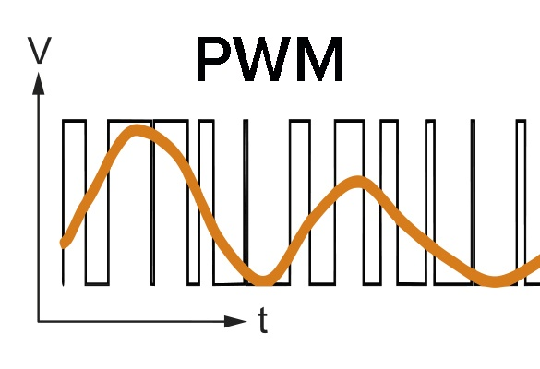
Features:
PWM
sine wave

Slide 16
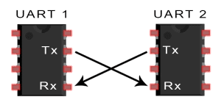
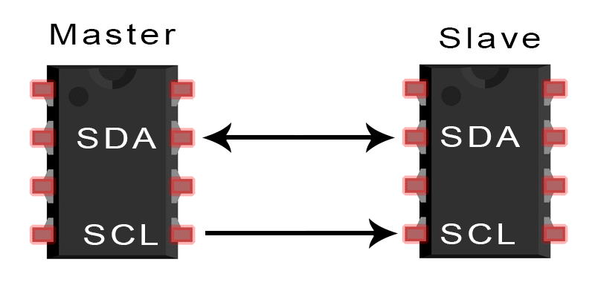
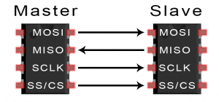
Features:
protocols
UART
I2C
SPI
https://wiki.bi0s.in/hardware/basic-electronics/protocols/

Slide 17
Quiz time!

Slide 18
What is I2C, SPI and UART?
a) type of sensors used to communicate with
b) type of communication protocol
c) type of Arduinos with network capabilities

Slide 19
What is I2C, SPI and UART?
b) type of communication protocol

Slide 20
What are the main features of Arduino
a) Simple integrated operating system
b) Simple integration with mice and keyboards
c) Integrated programmer and simple design

Slide 21
What are the main features of Arduino
c) Integrated programmer and simple design

Slide 22
What was designed in Ivrea?
a) The first Arduino boards
b) The Shield version of the board
c) The newest integrated development environment

Slide 23
What was designed in Ivrea?
a) The first Arduino boards

Slide 24
Questions?

Slide 25
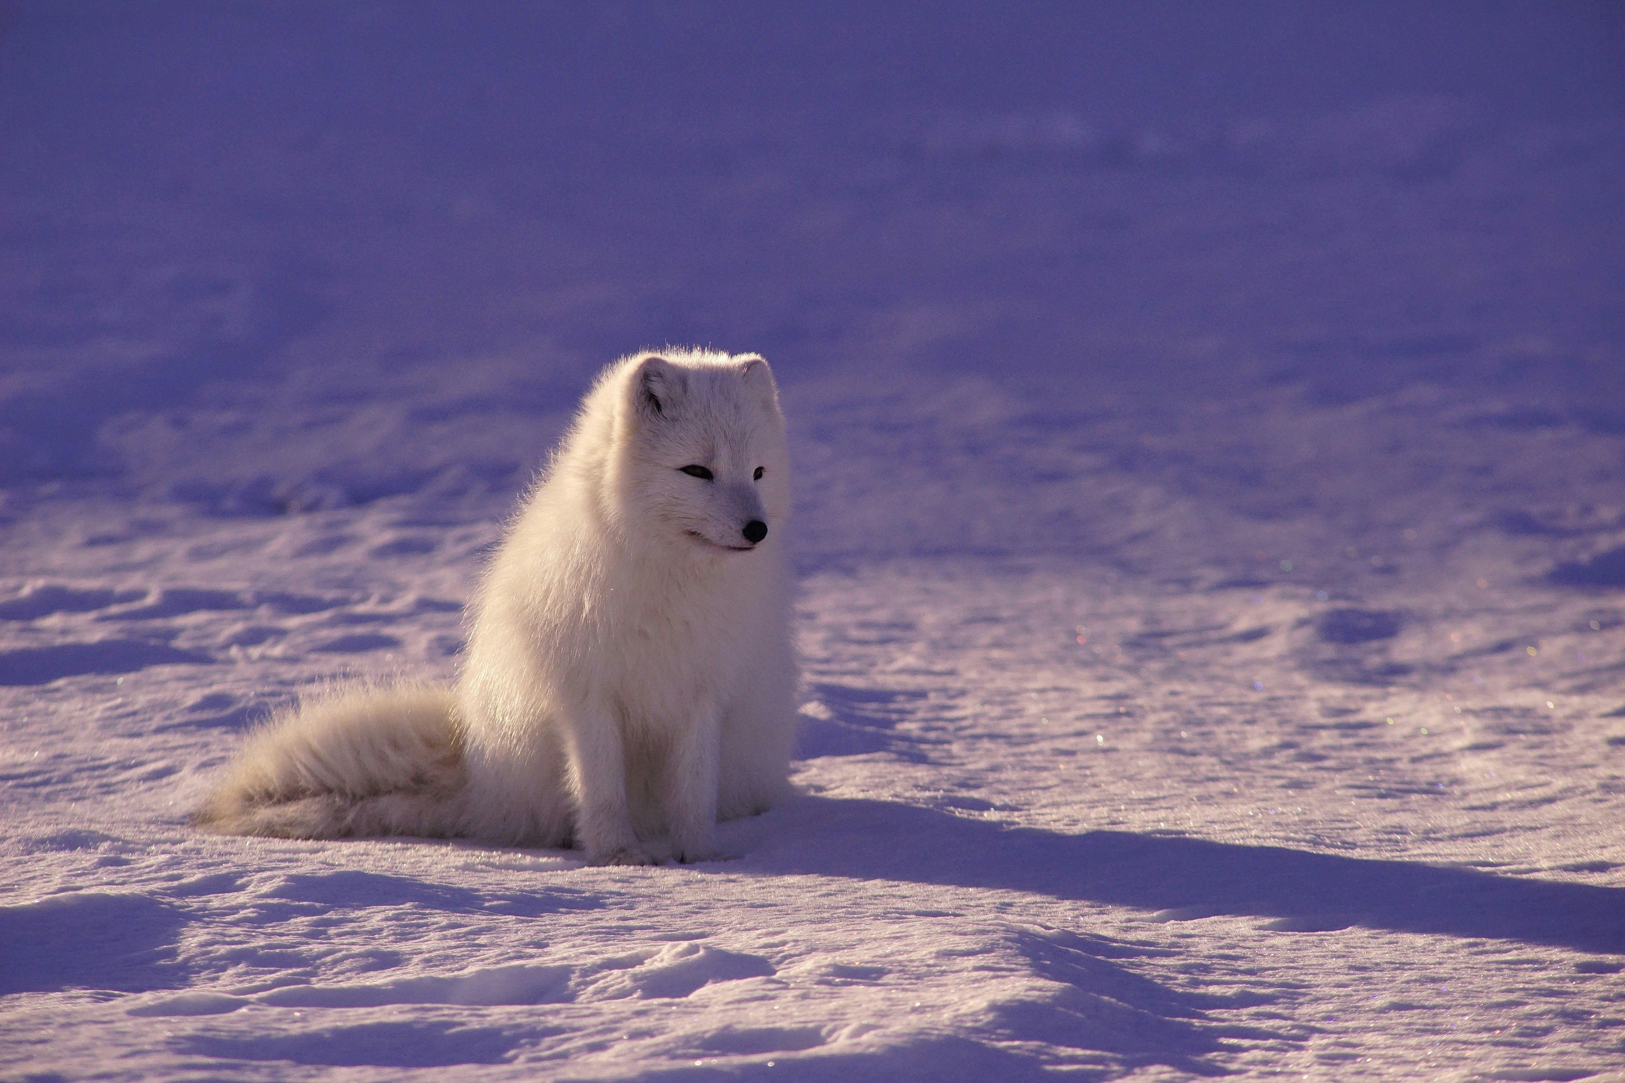
Thank you for your attention!

